Slide 1
Accelerate the future of CX with AI

Slide 2


Sherwin Que
Vice President, Product Support-APAC & Philippines Site Leader

Slide 3
Genesys is a global leader in cloud-based and AI-driven customer experience solutions, helping businesses deliver seamless, personalized, and empathetic interactions across voice, digital, and social channels.
Our flagship platform, Genesys Cloud CX, unifies customer and employee experiences through intelligent routing, automation, real-time analytics, and workforce engagement tools. With a strong focus on AI-powered Experience Orchestration, Genesys enables organizations to shift from reactive support to proactive, predictive service that enhance both customer satisfaction and operational efficiency.
Trusted by companies worldwide, Genesys is redefining how businesses connect with their customers by making every interaction feel more human.

Slide 4


“
Goods are fungible,
services are intangible, and
experiences are memorable.
— B. Joseph Pine II & James H. Gilmore
The Experience Economy: Work is Theater & Every Business a Stage
Notes:
Slide 1: The Experience Economy Quote
Talking Points (2 minutes)
Let’s start with a fundamental truth: "Goods are fungible. Services are intangible. Experiences are memorable."
This shift from a service economy to an experience economy is happening now.
In the past, businesses focused on transactions—delivering a product or completing a service.
Today, customers expect more: seamless, personalized experiences that make them feel valued.
Example: Think about streaming services vs. cable TV. Streaming platforms don’t just sell movies; they curate personalized recommendations based on your habits—driving engagement and retention.
Key question: How are you orchestrating experiences for your customers to make them memorable?

Slide 5

Notes:
Slide 1: The Experience Economy Quote
Talking Points (2 minutes)
Let’s start with a fundamental truth: "Goods are fungible. Services are intangible. Experiences are memorable."
This shift from a service economy to an experience economy is happening now.
In the past, businesses focused on transactions—delivering a product or completing a service.
Today, customers expect more: seamless, personalized experiences that make them feel valued.
Example: Think about streaming services vs. cable TV. Streaming platforms don’t just sell movies; they curate personalized recommendations based on your habits—driving engagement and retention.
Key question: How are you orchestrating experiences for your customers to make them memorable?

Slide 6


Experience Orchestration
Orchestrate customer-facing
activities across front- and back-office.
Reimagine the contact center,
customer & employee experiences,
and the business overall.

Slide 7
Experience Orchestration
Automate
Customer Experiences
Personalize
Empathetic Experiences
&
Augment
Employee Experiences
Optimize
Experiences Continuously

Slide 8
AI is a Strategic Imperative
Notes:
All of this means that AI isn't just an option anymore; it's a strategic imperative.
To stay ahead, you need a solid plan.
Without AI, businesses risk falling behind competitors who are using these advanced tools to meet and exceed customer expectations.
A strong AI strategy involves investing in the right tools, training your team to use AI effectively, and continually refining your approach based on new data.
It's about staying flexible and proactive, ensuring you not only meet customer needs today but also anticipate what they'll want in the future.
We're building for a future powered by AI, where these intelligent systems will enhance and transform how we connect with and serve our customers
So, with this vision of the future in mind, how can we prepare in the near term?

Slide 9
The Levels of Experience Orchestration

Slide 10

SERVICE ECONOMY
EXPERIENCE ECONOMY
Level 4
Level 5
Level 3
Empathetic
Experience
Generation
Universal
Orchestration
Level 2
System
Generated
Conversations
Level 1
Pre-Defined
Dialogue
Automation
Level 0
Menu-Based
Navigation
Zero Orchestration
Transcribed
Voice-Only
Limited
Transactional
Omni-Channel
Rigid
Prescriptive
Personal
Efficient
Emotion-Aware
Omni-Lingual
Synergetic
Proactive
Hyper-Personal
Self-Adjusting
Notes:
Slide 2: Levels of Experience Orchestration
Enter the Levels of Experience Orchestration
Genesys developed the the Levels of Experience Orchestration as a simple framework to help organizations navigate this transformation. It outlines a path to help companies understand the broader AI journey; see what’s possible; and take the next steps to modernize their customer experiences, drive more value and deliver more connected experiences.
Talking Points (2 minutes)
Businesses are at different levels when it comes to experience orchestration.
Most companies today are at Level 1 or Level 2:
Level 1: Basic interactions—think of pressing 1 for support in an IVR system.
Level 2: Some automation, but experiences are still rigid and transactional.
The Experience Economy starts at Level 3, where AI anticipates needs, adapts in real-time and personalizes interactions.
Example: Picture an airline experience after a canceled flight.
Level 1 & 2: You get stuck on hold, repeating your booking info.
Level 3+: The airline detects a canceled flight, automatically rebooks you, and offers a hotel voucher — all through an AI-driven assistant.
The takeaway: Companies that move beyond Level 2 are winning customer loyalty.

Slide 11

LEVEL 0
Zero
orchestration
Humans
handle everything
Fully manual Inefficient and slow
Notes:
Level 0 is no orchestration.
Humans do everything right, they drive the conversation, find information, access back end systems, produce the customer experience, and the only way to improve it was to train people.
Most interestingly, the user experience for the customer was most of the time a busy signal. So again, I guess nobody in the room is level 0

Slide 12

LEVEL 0
Zero
orchestration
LEVEL 1
Menu-based navigation
Voice IVR
Skills Routing
No real AI
On-prem systems
Notes:
Level 1 automation means the use of IVR mostly around voice channels, where you can actually augment the experience for the employee by providing customer data.
Historic data on the fly, where you have routing and skills management in order to generate the experience and to optimize your.
That's it. Not a lot of AI, and honestly, if you're still on premise, that's probably where you're going to get stuck level one.

Slide 13

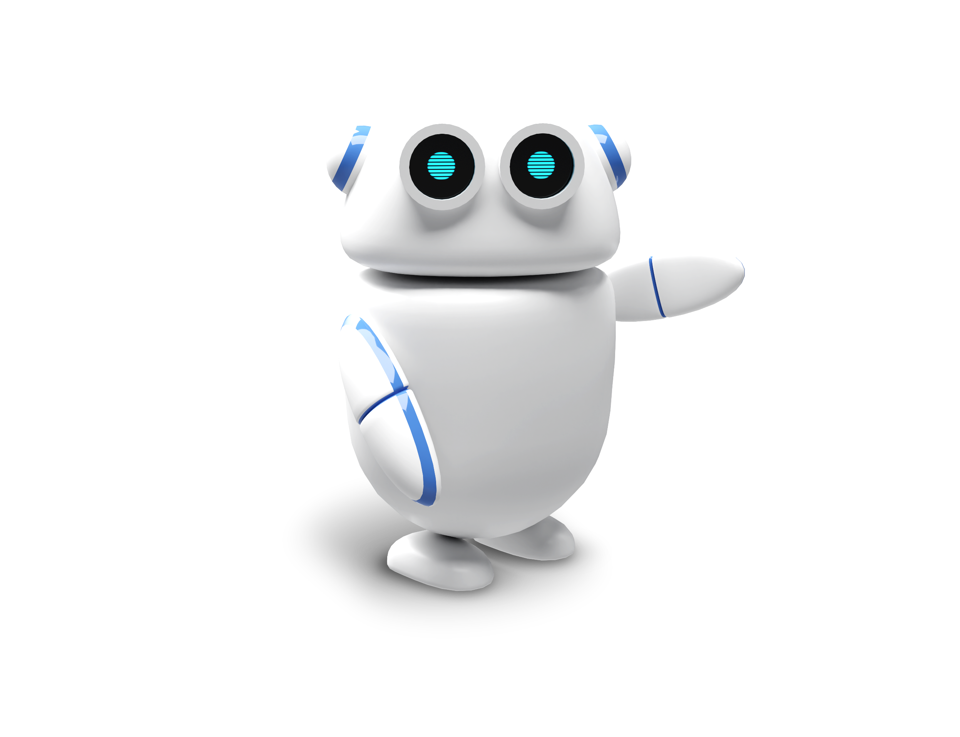
LEVEL 0
Zero
orchestration
LEVEL 1
Menu-based navigation
LEVEL 2
Predefined dialog automation
Omni-channel bots
Simple tasks
RPAs, Workflows
Automation + People

Slide 14

LEVEL 0
Zero
orchestration
LEVEL 1
Menu-based navigation
LEVEL 2
Predefined dialog automation
LEVEL 3
System-generated conversations
Channel-less
Virtual agents and Copilots
Next best action
Routing + Personalization + automation
Efficient + Natural and Intuitive

Slide 15

LEVEL 0
Zero
orchestration
LEVEL 1
Menu-based navigation
LEVEL 2
Predefined dialog automation
LEVEL 3
System-generated conversations
LEVEL 4
Empathetic
experience generation
Empathetic virtual agents
Generate complex experiences
Some asynchronous experiences
Transaction to Connection

Slide 16

LEVEL 0
Zero
orchestration
LEVEL 1
Menu-based navigation
LEVEL 2
Predefined dialog automation
LEVEL 3
System-generated conversations
LEVEL 4
Empathetic
experience generation
LEVEL 5
Universal
orchestration
Virtual personal concierge
Anticipates needs
Autonomous experience generation
No human agents
(knowledge worker back-up)

Slide 17



AI-Powered Experience Orchestration
LEVEL 0
Zero
orchestration
LEVEL 1
Menu-based navigation
LEVEL 2
Predefined
dialog automation
LEVEL 3
System-
generated conversations
LEVEL 4
Empathetic
experience generation
LEVEL 5
Universal
orchestration

Slide 18

The Business Value of AI

Slide 19


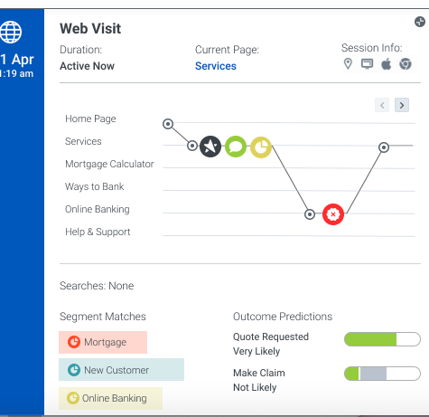


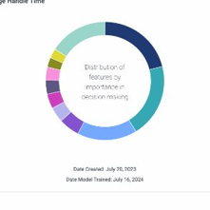


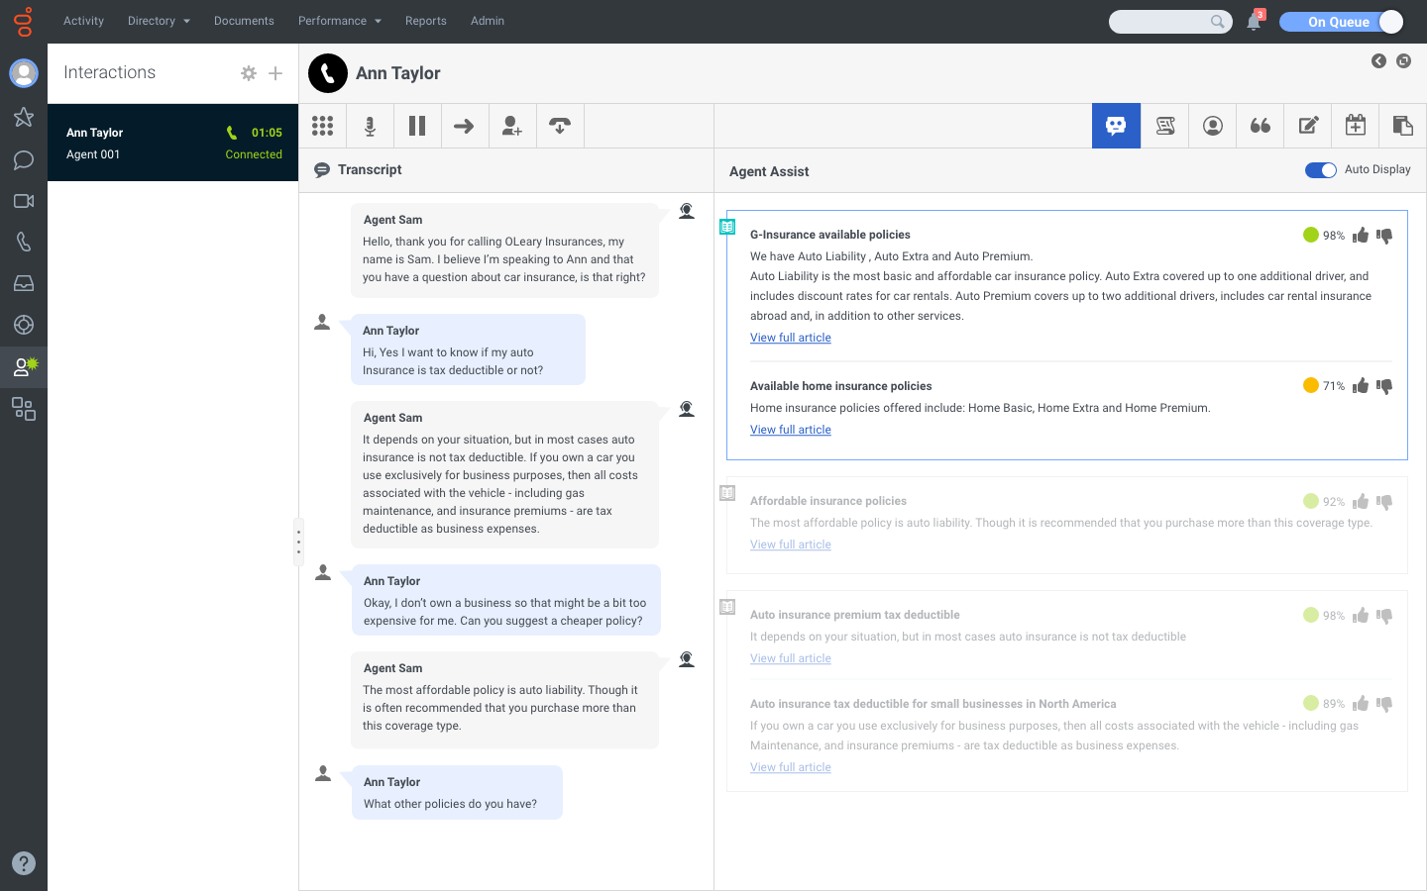
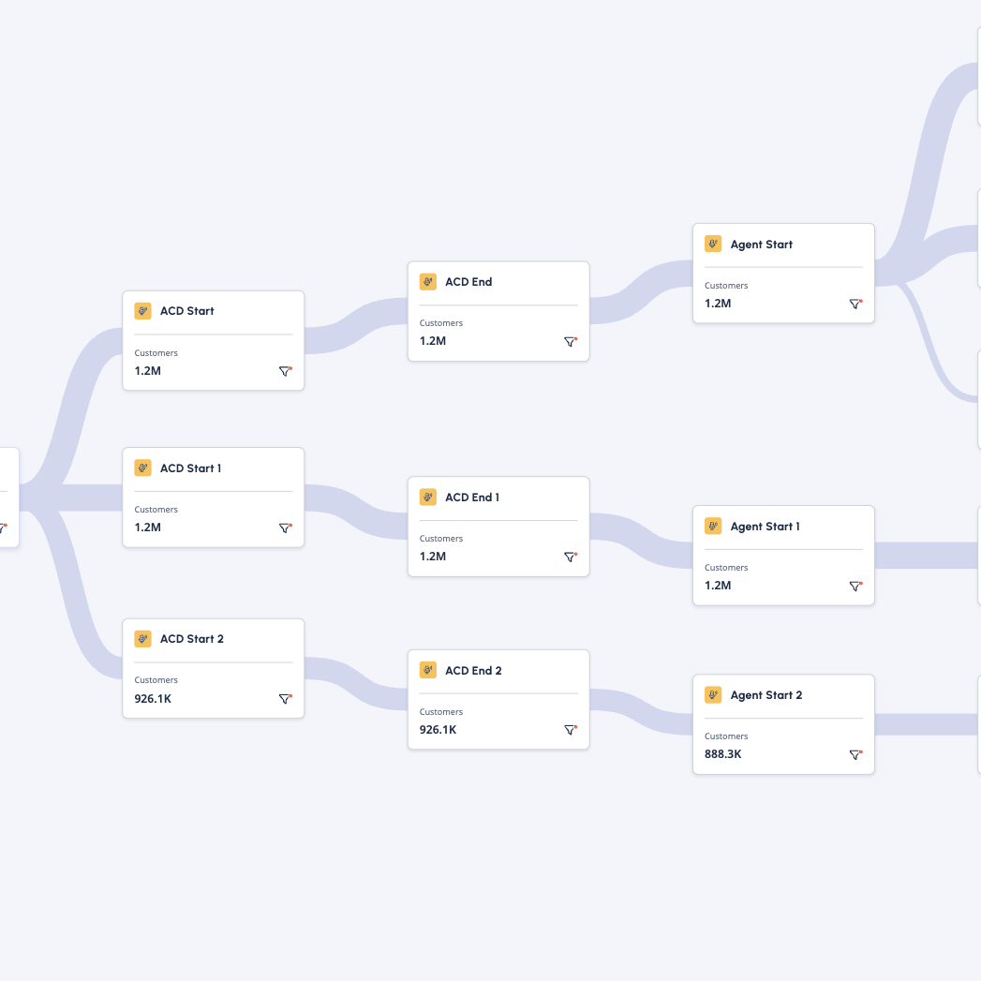
AI driving value across the entire journey
Customer needs help & goes to mobile app or website
Predictive Engagement
Customer Intent
  +68% in conversions
  +29% in revenue
  -72% in site dwell time
Predictive Routing
Virtual Agent
  -15% in handle time ​
  +14% in employee sat.
  ~$1.48M in cost savings annually
Agent takes over
Agent Copilot
  +50-70% in self-service
  70-80% containment
  ~50% FCR
  5-20% reduction in ACW
  +18% FCR
  20-25% handle time
STA
Journey Management
  146B words transcribed
  38.7K completed Quality Evaluations
Supervisor Copilot
Admin Copilot
Forecasting & Scheduling
  ~900M
  events analyzed
  900+ customers using Journey Flows
  Operational efficiency improvements
  Employee development boosted
  Faster time to production
  Reduced setup & configuration time
  26.7K AI Forecast refreshes
  130K Work Plans
Notes:
Now, let’s take look at the bigger picture - how Genesys AI creates end-to-end value across the entire customer journey.
For customers looking to go all-in on AI, we have the solutions to support them at every stage. But most organizations don’t start at full scale. Instead, they take a phased approach - proving value, iterating, and expanding. Each customer has a unique starting point, immediate challenges to address, and budget constraints. Our role is to understand these factors and guide them to the best path forward.
Remember, no two AI journeys are identical. Every implementation is unique, and that’s what makes Genesys AI so powerful. We don’t lock customers into rigid roadmaps or predefined use cases. Many – probably most - of our customers don’t know upfront which AI capabilities will deliver the greatest value; that's why we allow customers to start where it makes the most sense and scale from there.
Maybe Predictive Routing is delivering strong results, so they double down there. Maybe Virtual Agents are transforming efficiency, so they expand automation. The key is flexibility - Genesys AI is designed to evolve with their business.
And that flexibility isn’t just in how customers implement AI - it’s in how they pay for it too. With our AI Experience tokens, they can scale AI capabilities on demand without big upfront costs. Whether it’s Predictive Engagement, Virtual Agents, or other AI-powered solutions, they can easily experiment and reallocate tokens across different capabilities to optimize performance at every step.
That’s how our customers unlock exponential value over time - starting with proven impact and continuously expanding to maximize results.

Slide 20










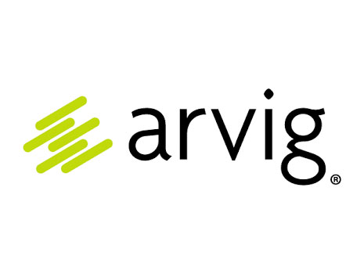


The Value of Leveling Up
Automation
Augmentation
Generation
Optimization
73% decrease in call abandonment rate
32% reduction in transfers
50% AHT reduction
60% reduction in
customer wait time
45% containment
$17M cost savings
13% AHT reduction
+20% donor reactivation
27% reduction in transfers
1 minute AHT reduction
115% increase in sales
12-day reduction
in customer time to value
Notes:
To just mention two customers with real business impact, take a look here at these two case examples.
Virgin Atlantic out of the UK with 12 pt increase in employee sat and 15% reduction in AHT in just 6 months of implementation of our new AI Experience
And NGM Group, an Australian regional financial services leader, has seen 1 min reduction in AHT and 2-3 minute reduction in after call work.
Later today you’ll hear from your peers at Westjet and Rogers about similar results they are experiencing in adoption of Genesys Cloud.
But what does that actually mean? How is AI… the solution?
AI is the key to overcoming the customer loyalty challenge because it enables hyper-personalized experiences at scale.
It offers the unique ability to analyze vast amounts of data in real-time, providing insights that enable businesses to personalize every customer interaction.
This level of personalization ensures customers feel valued and understood, which is the key to building and maintaining loyalty.
AI can also predict customer needs before they arise, enhancing self-service options and proactive support.
By leveraging AI, businesses can stay ahead of customer expectations and needs, ensuring smoother operations and a higher level of service.
And as work dynamics evolve and new generations join the workforce, prioritizing the employee experience is more important than ever.
AI can streamline and automate routine tasks, freeing up your employees to focus on more meaningful and engaging work.
This boosts their satisfaction and productivity, enabling them to deliver better service to your customers.

Slide 21
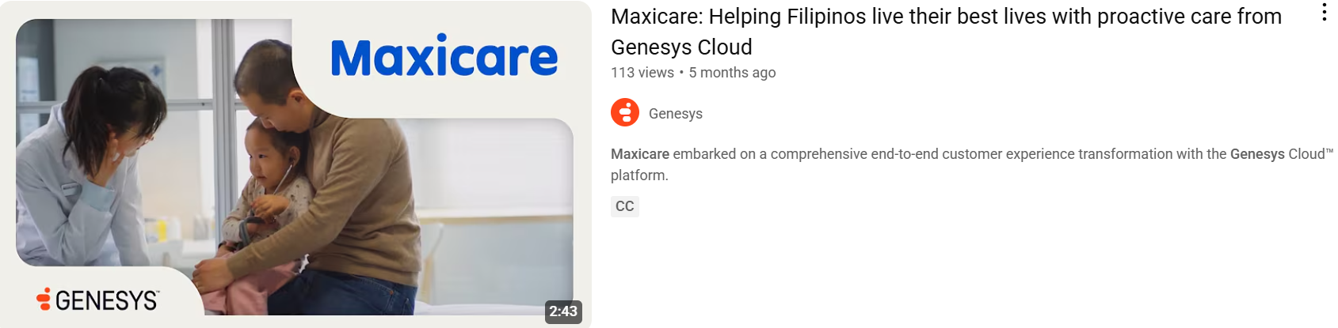
Watch the video here:
Maxicare: Helping Filipinos live their best lives with proactive care from Genesys Cloud

Slide 22

What analysts are saying
“
Genesys is offering organizations a robust entry point for autonomous AI, and the tools to help ensure every AI-powered customer interaction is secure, ethical and aligned to their strategy and values.
Scalable oversight of AI is critically important as we move into agentic decision-making and operation at lightning speed. For enterprises to leverage agentic AI, they must evolve how they approach AI governance and adoption.
Hayley Sutherland, research manager for conversational AI at IDC.

Slide 23



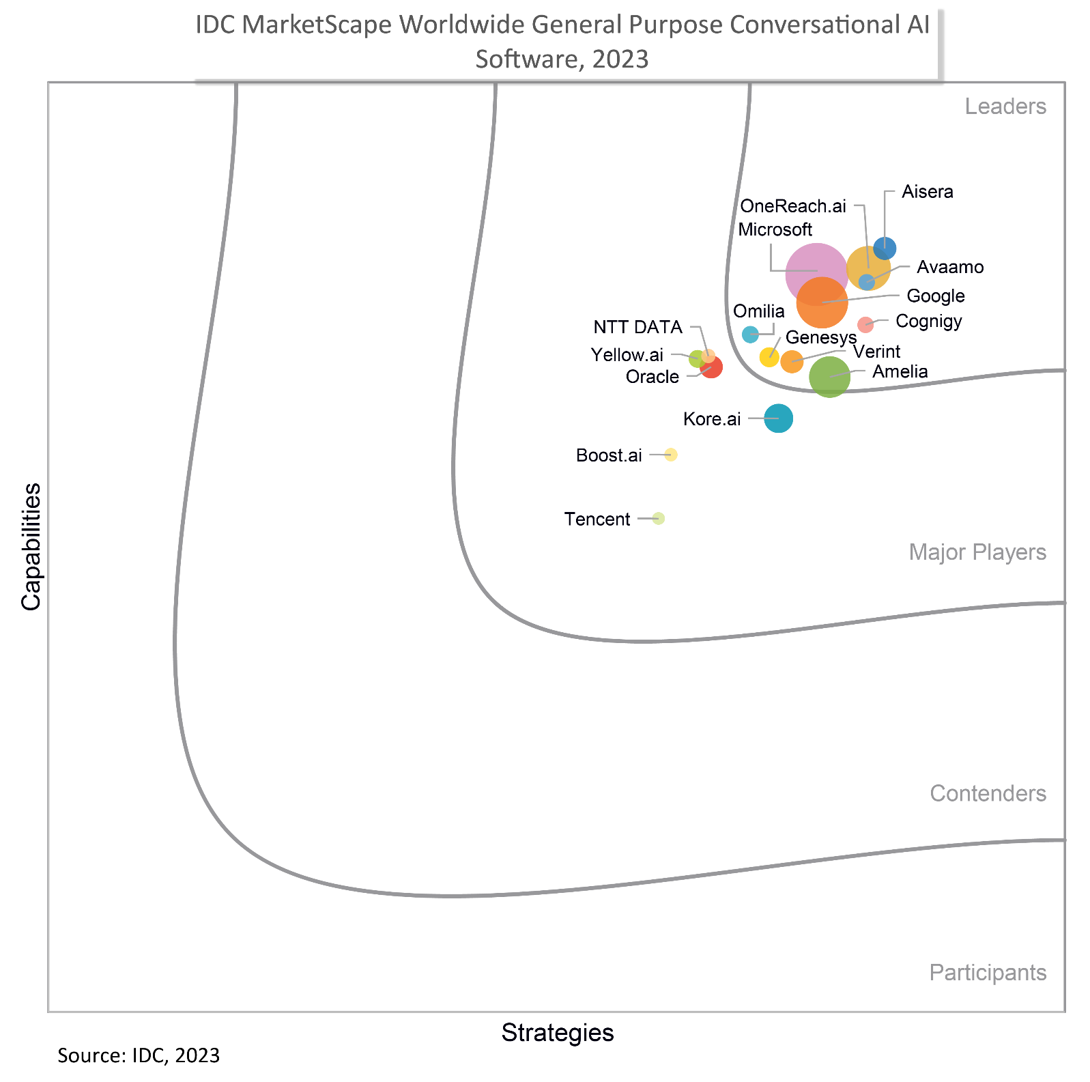
Best
AI products for 2024
Best
Use of AI
Best
Innovation for CX
Notes:
At the recent Enterprise Connect conference, Genesys won the award for Best use of AI and Best Innovation for Customer Experience.
We are recognized as a leader in two IDC’s MarketScapes: Conversational AI and Front-Office Conversational AI
G2 had us #12 on the list of best innovations for all AI software products in 2024. ChatGPT was two places away at #10.

Slide 24

We are here to accelerate
your AI journey into the future
Notes:
Thank you!

Slide 25
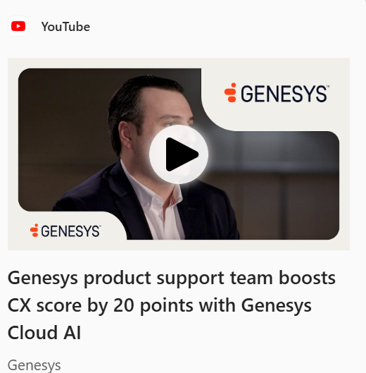
Watch the video here: Genesys product support team boosts CX score by 20 points with Genesys Cloud AI

Slide 26

Thank you
Let's continue the conversation
AsiaMarketing@genesys.com

